Slide 1
MANAGING an International Project
PROJECT MANAGEMENT

Slide 2
Agenda
Introduction of International Project Management
Challenges Facing International Projects
The International Project Management Framework
Summary

Slide 3
Introduction of International Project Management
What is international project management?
International project management is the leadership of projects that are conducted in multiple countries and cultures (Grisham, T. W., 2009).
Why it becomes a separate research direction in project management?
The trend of globalization has led to growing establishment of international projects.
However, executing international projects usually means lots of difficulties. Harrigan (1988) estimated the success of these projects is at about 50%, Hu and Chen (1996) estimated this number only as 6% based on the sample of joint ventures in China.

Slide 4
Agenda
Challenges Facing International Projects

Slide 5
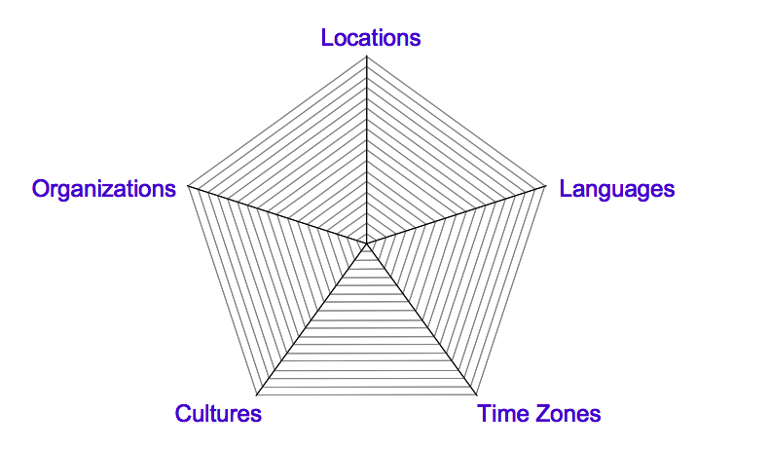
Challenges Facing International Projects
Global projects involve team members from various cultures and organizations, spread in locations across countries and time zones, and speaking different native languages. Each of these dimensions can contribute to the success of the team and the quality of the project deliverables, while adding challenges to project managers, PMOs and the team members.
Dimensions of International Projects (Binder, J., 2009)

Slide 6

Challenges Facing International Projects
Dimensions of International Project
Locations: work together independently of geographical situation – adding costs or demanding relocation.
Languages: English is not an universal language in France, Italy, Russia and China. Even a same English word can have different meaning in different language. What do you think a “yes” in China mean?
Time Zones: time zone differs, but working time is almost the same worldwide. Benefit may be “around-the-clock” effect.
Organizations: different organizations means different tools, knowledge, facilities, raw materials, processes, standards……

Slide 7
Challenges Facing International Projects
Cultures: misunderstanding faced by conflicting views on values and behaviors.
Culture is like water to a fish with visible and invisible elements, different cultures have different characteristics.
There are many researches focusing on cultural difference.
For example: Hofstede’s Framework – 4 dimensions of culture help explain behavioral similarities & differences.
Power Distance: “the extent to which the less powerful members of institutions and organizations within a country expect and accept that power is distributed unequally.
Uncertainty Avoidance: “the extent to which the members of a culture feel threatened by uncertain or unknown situations (Hofstede, 1991: 113)” and their ways of coping with this uncertainty.
Individualism: describes the relationship between the individual and society, i.e. whether importance is placed on the individual or the collectivity.
Masculinity: describes the effect that differences between genders have on social and emotional roles in society

Slide 8
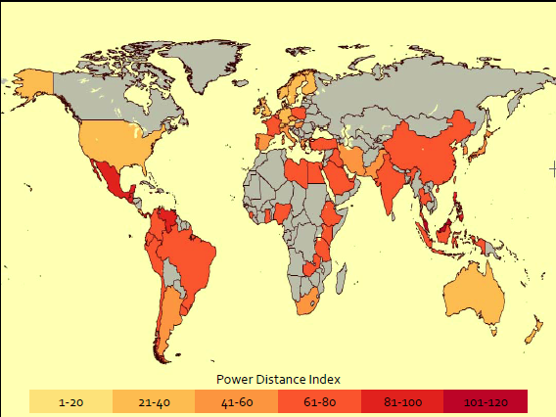
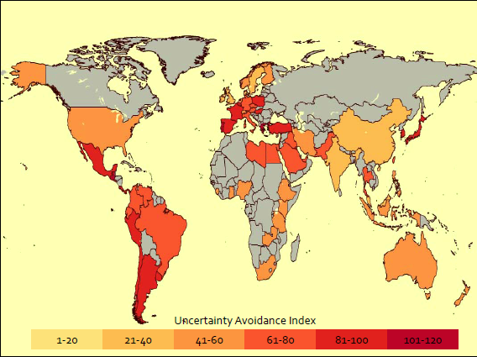
Challenges Facing International Projects
Result of Hofstede’s research

Slide 9
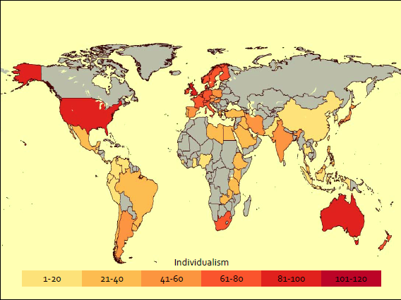
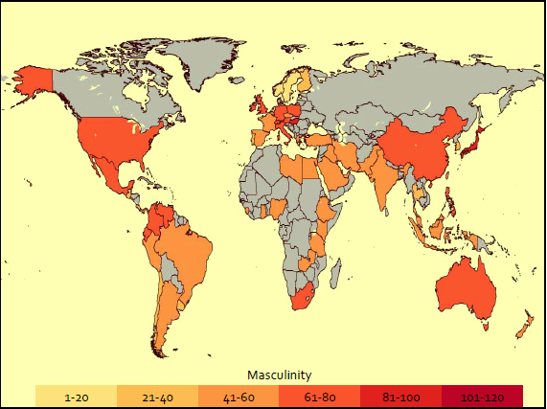
Challenges Facing International Projects
Result of Hofstede’s research

Slide 10
Challenges Facing International Projects
The above dimensions can be represented by a radical chart which could demonstrate the complexity of international projects.
The represents the lower complexity levels, while the combination of medium and high marks shows the higher complexity of projects across borders.
Organizations can use the scale above to establish comparisons among different projects, to decide when to apply the good practices and for risk management. More information on this is given throughout the book.
Notes:
A software development project– the project team members are working in four companies in different locations (the software company in London, England; one development team in Curitiba, Brazil; two development teams in Bangalore and Mumbai, India) with team members speaking four different native languages (English, Brazilian Portuguese, Kannada and Tamil), all with different levels of uency in English. There are three different country cultures, and the total difference in time zones is 8h30 in summer (GMT-3 for Brazil and GMT+5:30 for India). In addition to the team members, there are stakeholders from another three locations (three pilot customers in the USA, South Africa and Australia), elevating the number of country differences to six, and the time zone difference to 17 hours (GMT-8 for San Francisco, USA to GMT+10 for Sydney, Australia).
A pharmaceutical project– the project team members come from a partnership of eight organisations, and are working in six locations (two quality assurance teams in England, the headquarters in France, two laboratories in Germany and one development team in South Africa) composed of people speaking three different native languages (English, French and German). There are four different country cultures, and the total difference in time zones is 1 hour in summer (GMT+1 for England and GMT+2 for the other countries). In addition to the team members, there are stakeholders from another two organisations in different locations (The European Commission in Belgium and one environmental agency in Switzerland), elevating the number of country differences to six, without changes in the number of time zones or languages.
An organisational change project– the project team members from two organisations (the main corporation and one consulting company) work in 14 company of ces in ten countries, speaking eight different native languages. The total difference in time zones is 14 hours in summer (from New York ,USA, to Melbourne, Australia). In this case, all the stakeholders are in the same locations as the project team members.

Slide 11
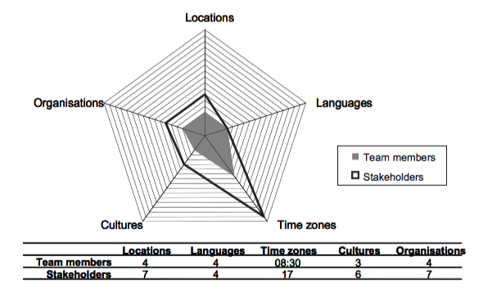
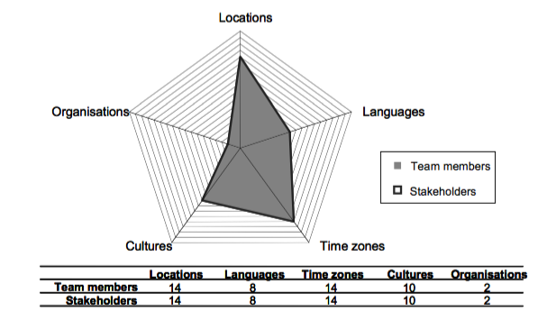
Challenges Facing International Projects
Some Examples of Analysis regarding International Projects
Notes:
A software development project– the project team members are working in four companies in different locations (the software company in London, England; one development team in Curitiba, Brazil; two development teams in Bangalore and Mumbai, India) with team members speaking four different native languages (English, Brazilian Portuguese, Kannada and Tamil), all with different levels of uency in English. There are three different country cultures, and the total difference in time zones is 8h30 in summer (GMT-3 for Brazil and GMT+5:30 for India). In addition to the team members, there are stakeholders from another three locations (three pilot customers in the USA, South Africa and Australia), elevating the number of country differences to six, and the time zone difference to 17 hours (GMT-8 for San Francisco, USA to GMT+10 for Sydney, Australia).
An organisational change project– the project team members from two organisations (the main corporation and one consulting company) work in 14 company of ces in ten countries, speaking eight different native languages. The total difference in time zones is 14 hours in summer (from New York ,USA, to Melbourne, Australia). In this case, all the stakeholders are in the same locations as the project team members.

Slide 12
Reflection Question
Can you describe one of your group work involving students from other countries, and did you meet any challenges in the above mentioned dimension?

Slide 13
Challenges Facing International Projects
The Most Frequent Causes of Failure in International Projects ()
1. Motivations: Failure to examine, clarify, and prioritize one’s motives and strategic goals
2. Selecting Partners: Failure to select partner organizations that complement one’s goals and mesh with one’s organizational culture style
3. Setting and Delivering on Goals: Failure to clarify operational objectives by achieving a clear and shared understanding of work objectives, performance targets, and management responsibilities
4. Setting Realistic Goals: Failure to set realistic objectives and a realistic pacing of implementation schedules
5. The Governance Issue: Failure to establish clear, mutually agreed on, and effective governance structures

Slide 14
The Most Frequent Causes of Failure in International Projects
6. Lack of Consultation and Consensus Building: Failure to consult with and integrate the substantive and process views and management practices of local colleagues and stakeholders
7. Commitment and Support: Failure by headquarters to maintain strong, consistent commitment and support to seeing the project through to a point of sustainability
8. The Project’s Political and Socioeconomic Environment: Failure to be proactive in environmental monitoring and management
9. The Challenge of Culture: Failure to recognize the pervasive influence of culture on all activities and to select and train personnel accordingly
10. Trust–The Tipping Point?: Failure to achieve a high level of mutual trust between the participating organizations and their employees

Slide 15
Reflection Question
Can you align/group the ten most causes of failure in international projects with above mentioned five dimensions of international project, to figure out the origins of these challenges?

Slide 16
The International Project Management Framework
The International Project Management Framework

Slide 17
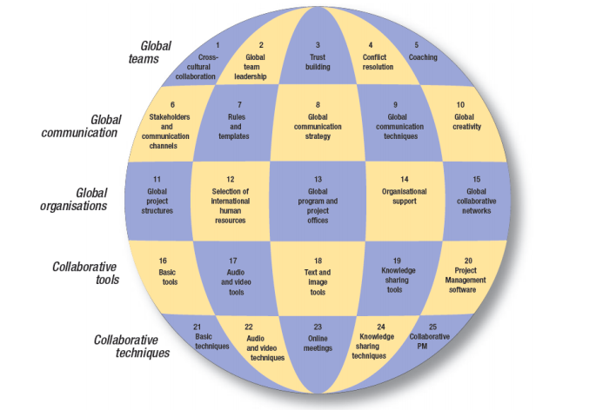
The International Project Management Framework
A frame work of good practices for international project management (Binder, 2009)

Slide 18
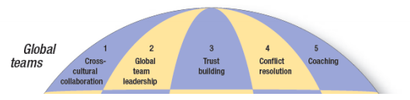
The International Project Management Framework
Cross-cultural collaboration
Using the dimensions, global project managers can recognize the invisible elements of the national cultures present in the project team, accepting the different mindsets and respecting them, and assigning people to the roles and activities that fit their communication style.
The culture dimensions can also be a rich source for risk identification and mitigation, when evaluated in early project stages.

Slide 19
The International Project Management Framework
Global project leadership – Global leaders must adapt their leadership, communication and management styles to the different cultures they work with.
They must develop an understanding of how to obtain commitment and improve the motivation level of the project team members, when having most of the meetings over a distance and outside office hours.
Universal Principles of Effective Leadership (Goleman et al., 2000; Collins, 2001)
Principle One: A leader needs to impart a vision providing focus to the organization
Principle Two: A successful leader is a servant of the people
Principle Three: You cannot manage people into greatness, they must be led
Effective Leadership in Multinational Environment, National Culture and Leadership (Rentfrow, 2007)
Step One: Serve the organization by adapting to the host culture
Step Two: Establish a corporate vision but do not abandon your national culture
Step Three: Lead people to greatness with humility and patience

Slide 20
The International Project Management Framework
Trust building – Some communication channels (between team members) are more likely to require a high level of trust, when they cross country borders or involve people who have never worked together before.
Identifying the weak communication channels and work in resolving this since the project initiation, in order to build trust.
The project planning phase is often a very good opportunity to bring the team together (or around a virtual table, over web or video-conferencing) and build trusted relationships, which must last until the project completion and form solid links for future ventures.
Conflict resolution – Project managers must pay special attention to the potential sources of conflict that are specific to global projects, identifying different techniques to act as a mediator, assess the situation and resolve the conflict to the best interest of the project objectives.

Slide 21
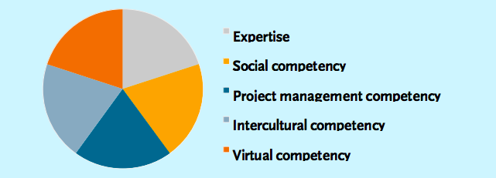
Coaching – Coaching is a powerful tool to develop trust and learn about the cultural differences.
A good coaching process starts with a clear definition of goals, continues with a periodic review of the achievements, and stops with a structured review of the learning and next steps.
Five areas of competency are essential for project teams, and especially for management, in order to guarantee the success of international projects (Mitte Consult):

Slide 22
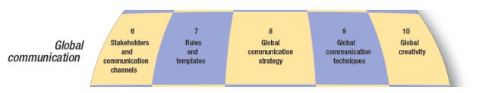
The International Project Management Framework
Stakeholders and communication channels – The identification, analysis and management of global stakeholders involve the team members, who are best placed to understand and influence the stakeholders on their geographical area. The project managers must lead this task, and provide coaching and support for this process to be effective. On the other hand, the communication channels that span geographical and cultural borders must be identified and receive special attention.

Slide 23
The International Project Management Framework
Rules and templates – Global project teams must define together the basic rules to select the best communication media for each meeting type. They must also agree upfront on the templates to be deployed throughout the project, keeping in mind that the documents will be prepared and reviewed using synchronous and asynchronous electronic media.
Global communication strategy – The main members of the global project team must define the most frequent types of project information, and identify the stakeholders’ requirements. A good communication strategy for a global project specifies the relationship between each key stakeholder and the main information types, defining the best media and manner for the communication to take place.

Slide 24
The International Project Management Framework
Global communication techniques – Global project managers and project office members must master the techniques to collect information from geographically distributed team members, exchange project information with the main team members, and distribute the project status and reports to key stakeholders.
Global creativity – The uniqueness of project deliverables requires the global team members to unite their creative minds. Brainstorming sessions are widely used around white boards and flip charts. Global project managers must use a different set of tools and techniques to foster creative ideas and capture fuzzy knowledge in online meetings.

Slide 25
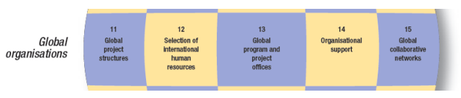
The International Project Management Framework
Global project structures – different structures such as project managers communicate directly to all key team members in centralized structures.
In distributed structures, project coordinators are nominated to monitor the planning and execution of a group of team members in the same geographical location, organization or knowledge area.
Selection of international human resources – specific skills required for international projects. Special skills also help to conduct interviews over a distance, and good preparation of questions and the communication media is the key factor for a successful selection process.

Slide 26
The International Project Management Framework
Global PMO – Program or Project Management Offices can provide various services to improve the success rate of global projects.
Knowledge management services allow standard practices during the collection and distribution of project information.
Portfolio management services make sure that consistent rules are deployed across departmental and geographical borders on the project selection, prioritization and allocation of resources. Health checks, coaching and training services can help project managers across the globe to use the same processes, methods and templates, and to master the communication and leadership techniques essential to international initiatives.
Individual, departmental, and corporate PMOs.
(Giraudo, L. & Monaldi, E., 2015)

Slide 27
The International Project Management Framework
PMO Competency Continuum (Hill, 2004).

Slide 28
The International Project Management Framework
Organizational support – Global organizations, alliances and partnerships must adapt their processes and policies to provide support to global project team members. Senior executives and HR departments must understand the differences across corporate and country borders, to determine what elements can influence the motivation of the international working force. Emotional Intelligence, work-life balance and international performance appraisal systems are some examples of motivational factors to be carefully evaluated.
Global collaborative networks – Organizations are evolving from multinational enterprises to international networks, which aggregate the main suppliers, producers and customers with their subcontractors and service providers. These alliances and partnerships are often sealed around a group of programs and projects. Senior executives must understand the different challenges faced by the global teams, in order to define collaboration strategies during early stages. Examples of these challenges are the different corporate cultures and maturity levels in project management, processes and procedures.

Slide 29
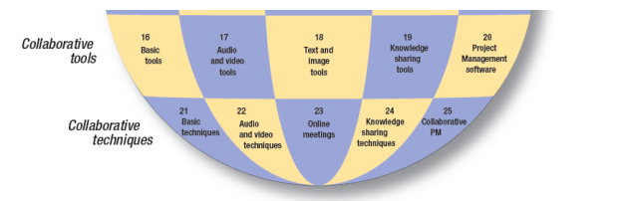
The International Project Management Framework

Slide 30
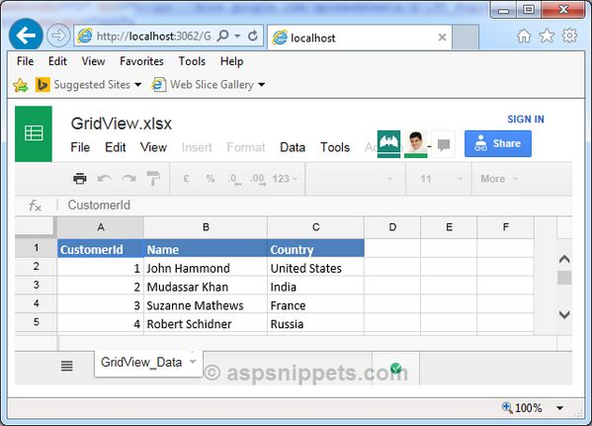
The International Project Management Framework
Basic tools and techniques –
Simple tools are the foundation for collaboration across team members. -telephones, e-mails and remote access to corporate systems. Are they used efficiently?
Other simple solutions might also provide a great help, such as shareable spreadsheets, websites dealing with meeting times in various time zones, and tools that help organizing meetings between people from different companies.

Slide 31
The International Project Management Framework
Audio and video tools and techniques –The main barriers are the technical difficulties to start the calls – mainly when connecting equipment from different companies – and the quality of sound and video. These elements must be taken into consideration when evaluating the technical solutions and preparing training and documentation to help the meeting coordinators.
Text and image tools, used during online meetings – Establish (at the same time) an audio-conferencing call and a web-conferencing session, then share spreadsheets, mind mapping software or presentations. The meeting participants can visualize what is being capture and react (when they disagree) or add more information.
This reduces the probability of misunderstanding, and eliminates the need for late nights of writing meeting minutes, and long delays to have them approved by the meeting participants.
Knowledge sharing tools and techniques –The most common for business environments are Content Management Systems (CMS) that allow the publication of project news, the collaboration around documents, and the sharing of online tables to capture the risks, opportunities, issues, changes and stakeholders.

Slide 32
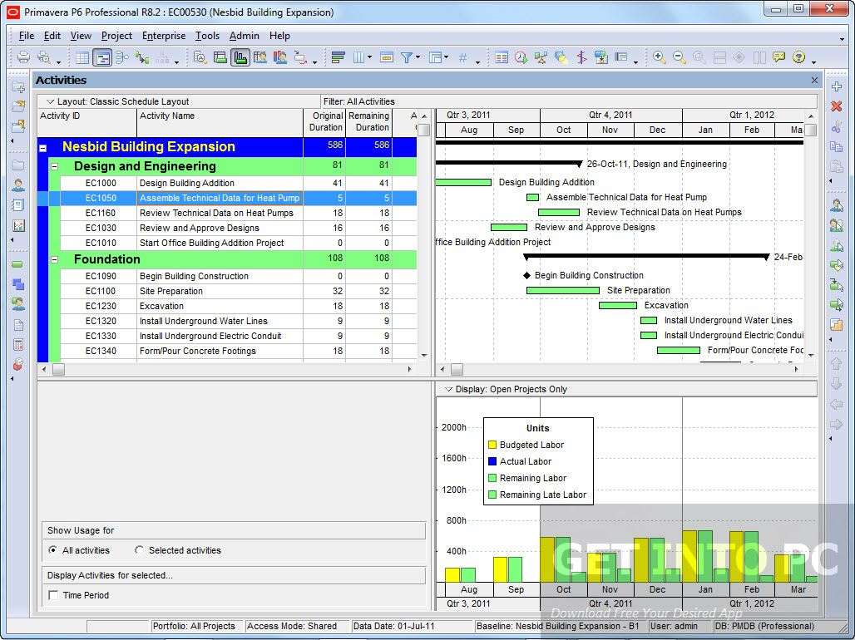
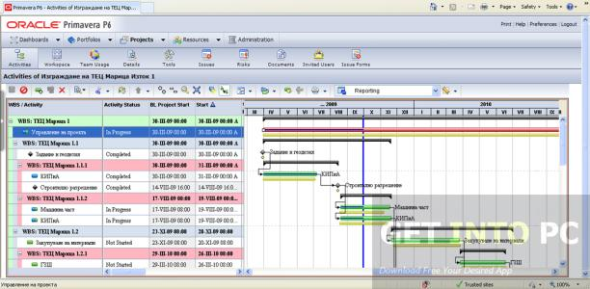
The International Project Management Framework
Collaborative Project Management Software – There are technology platforms that allow project team members to create and maintain the project management plan, to monitor the execution of the deliverables, to share the project logs, and to obtain approval from key stakeholders on documentation, business cases and closing reports. In global projects, the implementation of these platforms is essential for all processes that require effective collaboration across borders, such as defining activities, identifying and analyzing risks, directing and managing project execution, monitoring progress and controlling project work.
Example: Oracle of Primavera

Slide 33
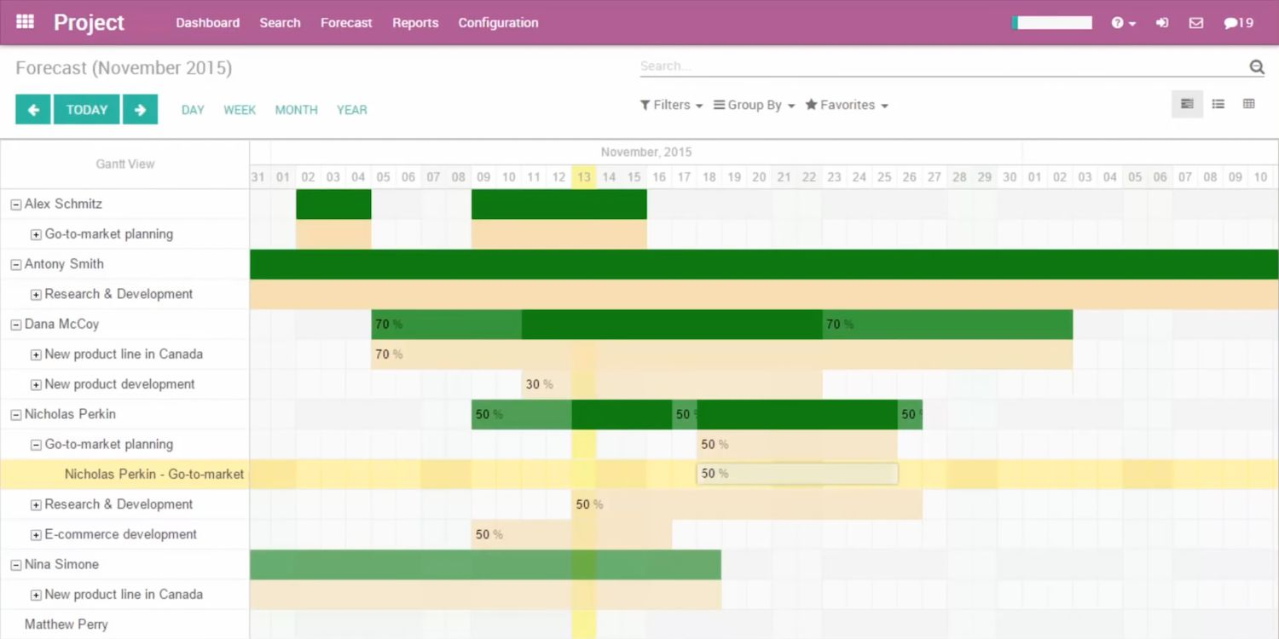
The International Project Management Framework
Example: Microsoft Project

Slide 34
Summary
International project managers must be ready to face the challenges of cross-cultural communication, different organizations, skewed time zones, multi-languages and collaboration across locations.
In order to become a successful international project leader, except traditional requirement, it is important to adapt to the host culture, establish a corporate vision but do not abandon your national culture and lead people to greatness with humility and patience
There are at least 25 areas to be considered when planning a global project. The International/ Global Project Management Framework provides a comprehensive set of practices and recommendations on these areas, aligned with organizational change variables.

Slide 35
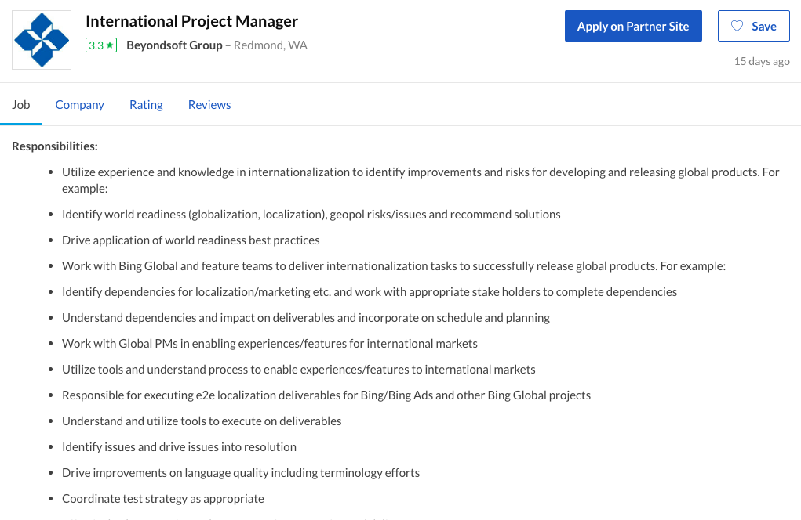
QUIZ
Check a job description of an international project manager. Can you align the practices with the requirement for international project manager?

Slide 36
Reference
Binder, Jean. (2009). The Global Project Management Framework: Communication, Collaboration and Management Across Borders. Conference Paper: PMI EMEA Global Congress.
Beyondsoft Group (2018). International Project Manager. Available at: https://www.glassdoor.com/job-listing/international-project-manager-beyondsoft-group-JV_IC1150499_KO0,29_KE30,46.htm?jl=2987603510&ctt=1540555105590.
Collins, J. (2001). Good to Great, Why Some Companies Make the Leap and Others Don’t. HarperCollins.
Kealey, D. J., Protheroe, D. R., MacDonald, D., and Vulpe, D. (2006). International Projects Some Lessons on Avoiding Failure and Maximizing Success. Performance Improvement, 45 (3), pp. 38-46.
Giraudo, L. & Monaldi, E. (2015). PMO evolution: from the origin to the future. Paper presented at PMI® Global Congress 2015—EMEA, London, England. Newtown Square, PA: Project Management Institute.
Goleman, D. (2000). Leadership That Gets Results. Harvard Business Review. Harvard: Harvard Business School Publishing Corporation, Publication Number R00204.
Grisham, T. W. (2010). International Project Management: Leadership in Complex Environments.
Hill , G. M. (2004). Evolving the project management office: A competency continuum. Information Systems Management, Fall, 45–51.
Hofstede, G. (1980). Culture’s Consequences. International Differences in Work‐Related Values. Beverly Hills, CA: Sage.
Rentfrow, T. J. (2007). Effective Leadership within a Multinational Environment. Leadership Advance Online, Issue X.

